Slide 1


Team L14

Slide 2
1. Project Overview
Current Presenter:
Nicholas Appert
Client: Jonathan Potter
Client’s business:
Jonathan is a software developer who has been working on projects on the side, including the proof-of-concept for Shady Jones’ Locker.
Client’s “problem” to be solved:
Jonathan wants to make a service similar to the Shadertoy website
Users should be able to create, edit, share, and comment on WebGL GLSL shaders.
We were provided with a prototype he coded several years ago as an artifact
The proposed solution:
Shady Jones’ Locker!

Slide 3
2. Requirements
Current Presenter:
Ejiro Uwhuba
User login authentication system.
Users can create WebGL GLSL shaders using an in-browser code editor.
Users can configure and use a GUI to change the values of uniform variables without recompiling the shader. Other users cannot configure, but can use the GUI.
Users can search for and view shaders. Shaders are compiled and run on the users’ local machines.
Users can comment on, view comments on, and delete their own comments on shaders.
Administrative users can access the administrator page and perform administrative actions that we’ll see in a demonstration.

Slide 4
3. The Design and Demonstration of Shady Jones’ Locker
Current Presenter:
Zachary Wagner
A Model View Controller architecture used to design and develop our back-end and front-end.
Heroku Postgres - Model
Django Framework - Controller
HTML/Javascript/Bootstrap/React - View
Hosted on Heroku Cloud Service.
Shady Jones’ Locker was designed for users to easily create accounts/login and view/write GLSL code.
We will now watch a demonstration of Shady Jones’ Locker.

Slide 5
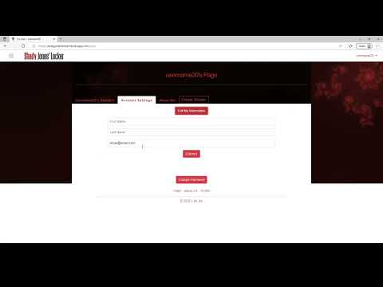
Our Demonstration!

Slide 6
4. Implementation
Current Presenter:
Sean Jahangiri
How the product was implemented using SCRUM:
Used Jira Software to list and create tasks for each sprint
Everyone was tasked at least one to two tasks per sprint
The technologies used to implement the product:
IDE’s - Visual Studio Code, PyCharm
Languages - Python (Django Backend), HTML, CSS, JavaScript, (Bootstrap, React, WebGL)
Postgres Database
Hosted on Heroku
The amount of work completed:
Over 100 total files created!
Over 100 total hours!
Over 80,000 lines of code!

Slide 7
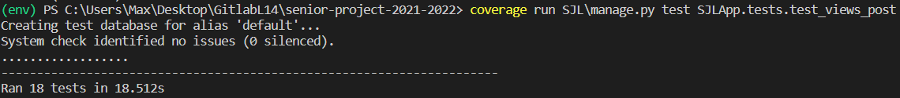
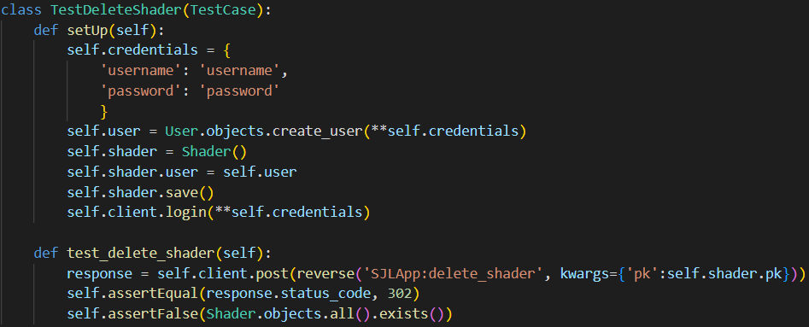
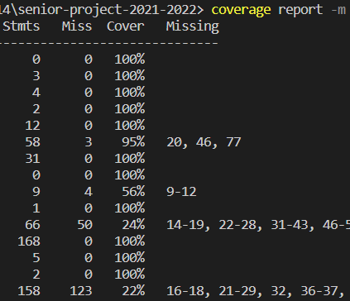
5. Testing - Unit Tests
Current Presenter:
Maxim Jeleznii
Unit tests are done using Django’s testing environment.
Coverage tracked with the coverage package

Slide 8
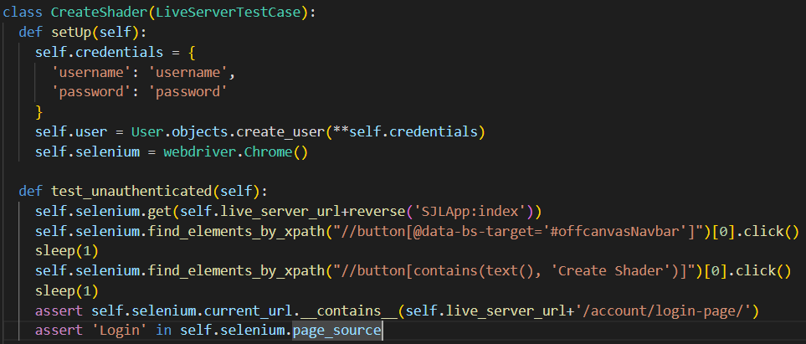
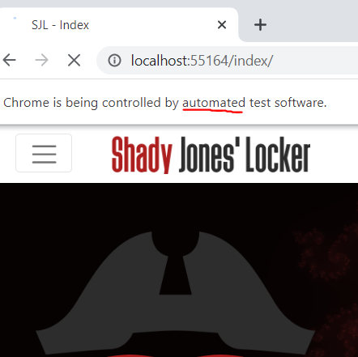

5. Testing - Integration Tests
Current Presenter:
Maxim Jeleznii
Integration Tests done using Selenium for python using Chrome.

Slide 9


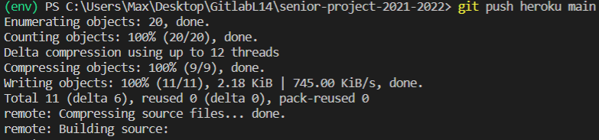
6. Deployment
Current Presenter:
Maxim Jeleznii
We have deployed on Heroku, a free hosting platform.
All that was needed was a set up Procfile, Heroku CLI, and the heroku-django package.

Slide 10
7. Lesson learned
Current Presenter:
Alex Toral
Things we learned in this class
Django
Bootstrap
CSS
Javascript
Python
Some insights/wisdom that our team would like share with the class
Communication with client
Establish a safe environment amongst the team
Do not be afraid to ask teammates for help
Do not procrastinate

Slide 11

8. Conclusion
Current Presenter:
Sid Hazle
“This is exactly what I wanted” - Jonathan Potter, client
Things to be improved (if any)
Website could use more time spent testing niche cases
Practice, practice, practice agile techniques

Slide 12
Q&A

